Slide 1
Presentation
of
Volvox

Slide 2
Systematic Position
Division: CHLOROPHYTA
Class: CHLOROPHYCEAE
Order :VOLVOCALES
Sub-order: CHLAMYDOMONADINEAE
Family: SPHAERELLACE AE
Genus: Volvox

Slide 3
INTRODUCTION, OCCURRENCE AND IMPORTANCE
Volvox is a chlorophyteean (green) alga. It exists as a grand spherical colony. Each little alga within the colony bears two whip-like flagella (hairs). The individual algae are connected to each other by thin strands of cytoplasm that enable the whole colony to swim in a coordinated fashion. Each individual alga has a small red eye spot.
The colonies have what can be called a front and rear end: or, (since Volvox resembles a little planet), a 'north and south pole'. Towards the northern end, the eyespots are more developed. This helps the colony to swim towards the light. This differentiation of cells makes ' olvox quite unique. It is a colony that really comes close to being a multi-celled organism.

Slide 4
VEGETATIVE STRUCTURE
The plant body of Volvox is multicellular motile coenobium (a coenobium is defined as a colony with fixed number of cells arranged in a definite manner). The coenobia of Volvox are spherical, oval or ellipsoidal in shape. The size of mature coenobium is usually 0-5 mm in diameter. The central hollow cavity of coenobium is filled with mucilage. Each cell is biflagellate and the alga rolls over the surface of water bv the joint action of flagella.
The coenobium of Volvox is an assemblage of similar and independent cells. Each cell perforn is its own function of nutriton, respiration and excretion.

Slide 5
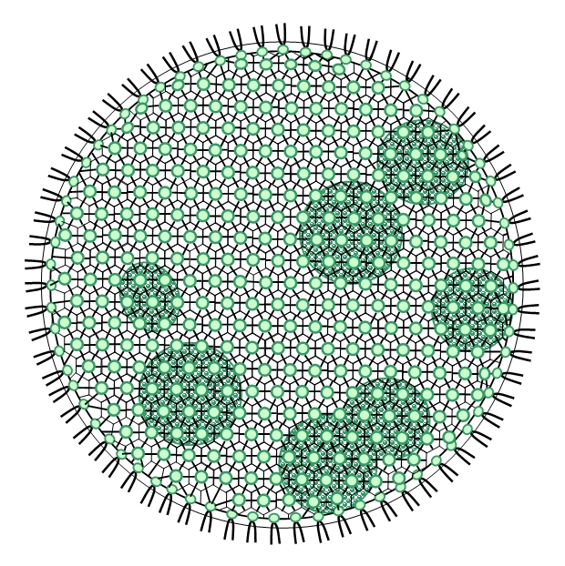
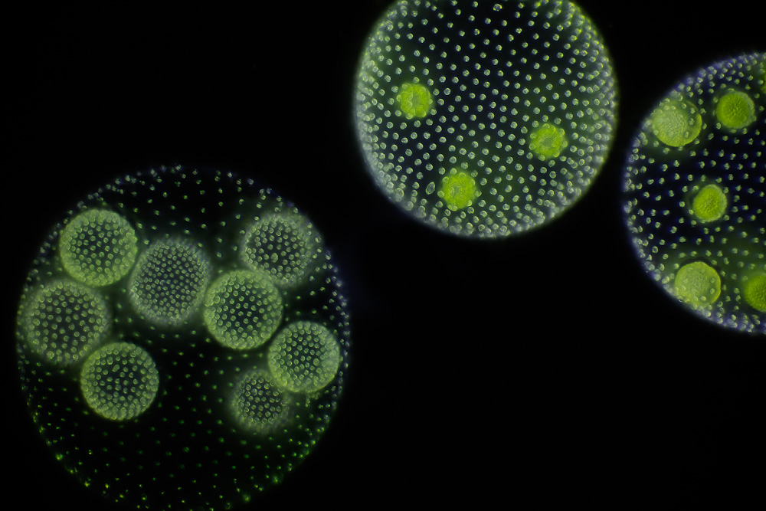
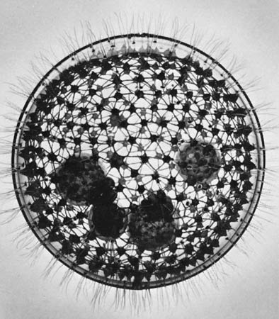

Slide 6
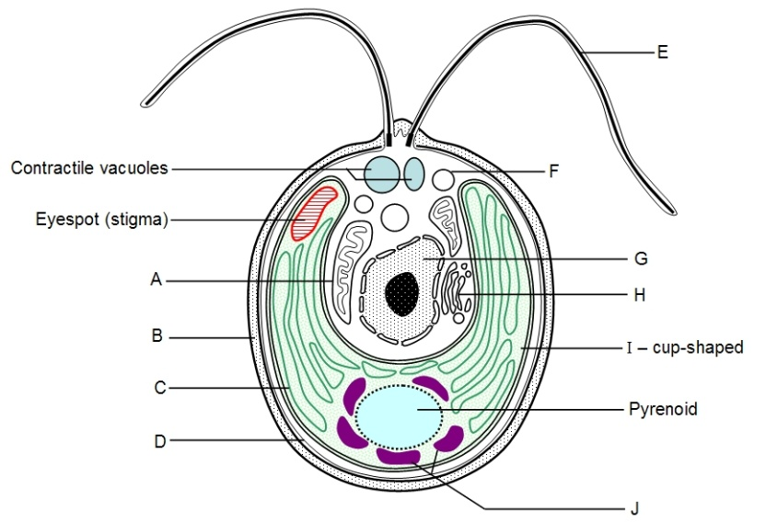
Structure of single cell
The individual cell of Volvox is spherical, elliptical or oval. It is biflagellate. The two whiplash type of flagella are attached to anterior end. The cell has a thick cell wall differentiated into outer firm and inner mucilaginous layer. Several contractile vacuoles (2 to 6 in number) are distributed near the surface of protoplast. Each cell has single cup-shaped or curved plate like chloroplast, which possesses chloroplastic pigments characteristic of green algae i.e., chlorophyll a, chloro­phyll b. carotenoids and xanthophylls. The chloroplast is associated with 1 or 2 pyrenoids. Single nucleus is situated in the hvaline portion of cytoplasm. The nucleus is connected with the neuromotor apparatus consist­ing of blepharoplast, rhizoplast and centromere. Each cell has a single eye spot at the anterior end.
.

Slide 7
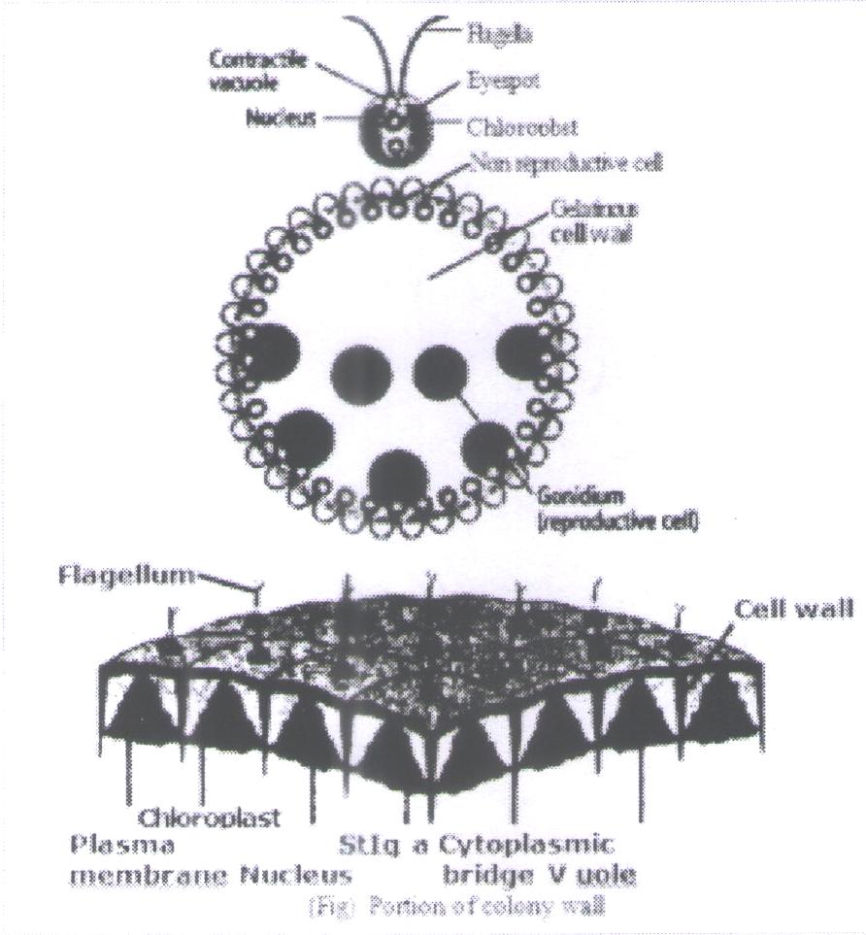
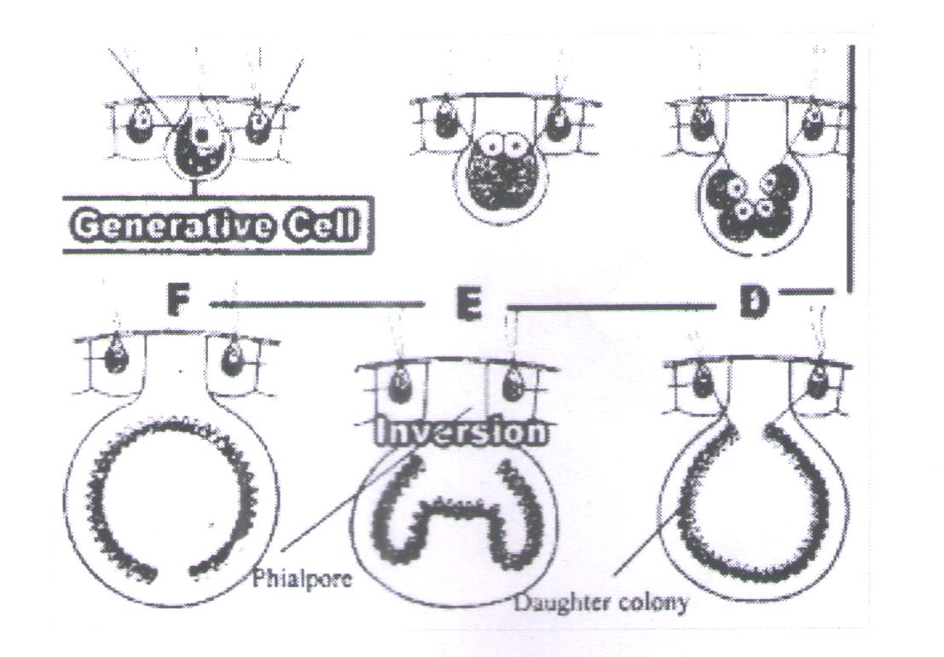
Asexual reproduction
New colonies are produced within the parenfcolonies during asexual reproduction. Only certain cells at the posterior end of the colony take part in the asexual reproduction. The size of these cells increases. They become ten times larger. These cells are called gonidia. Gonidia develop numerous pyrenoids. There are 5 — 20 gonidia in each colony. They produce daughter colony within the parent colony.
Release of daughter colony: Sometimes, a pore is produce in the wall of parent colony. Thus daughter colony comes out from parent cells and it become free. In some case, it remains within the parent colony. The parent colony disintegrates and releases the daughter colony.

Slide 8
SEXUAL REPRODUCTION
'Sexual reproduction is oogamous type. Theniaie sex organs are antheridia (androgonidia) and female sex organs are oogonia.
Sexual reproduction begins at the end of vegetative phase. Some cells at the posterior half of coenobium retract their flagella, enlarge and become gametangia. Each gamet-angium is large and rounded cell with many pyrenoids.

Slide 9
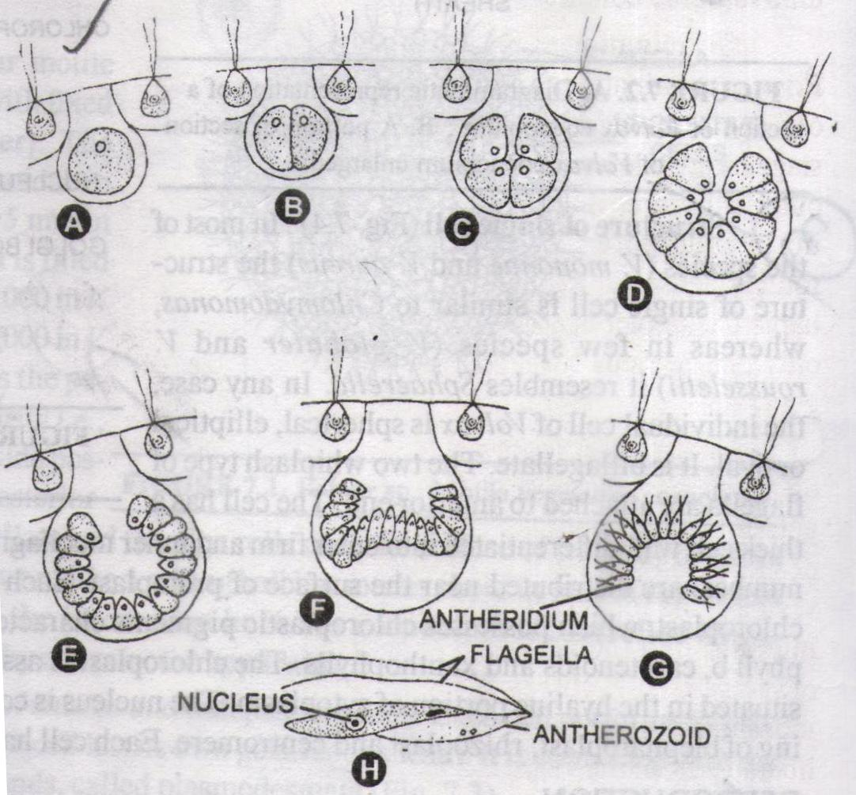
ANTHERIDRA (ANDROGONIDIA)
During its formation the protoplasm of gametangium divides by successive and simul­taneous longitudinal divisions forming a bowl shaped plate consisting of 64—128 male cells. The number of male cells varies from 16,32,64, 128 to 512 depending upon the species. The bowl is then inverted in the same manner as asexual colony. Each protoplasmic piece gets differentiated into long, narrow, conical motile antherozoid. It is uninucleate and possesses a small yellow green or pale green chloroplast. The mass of antherozoids (spermatozoids) is released at maturity which swims for sometime and then the antherozoids get separated.

Slide 10
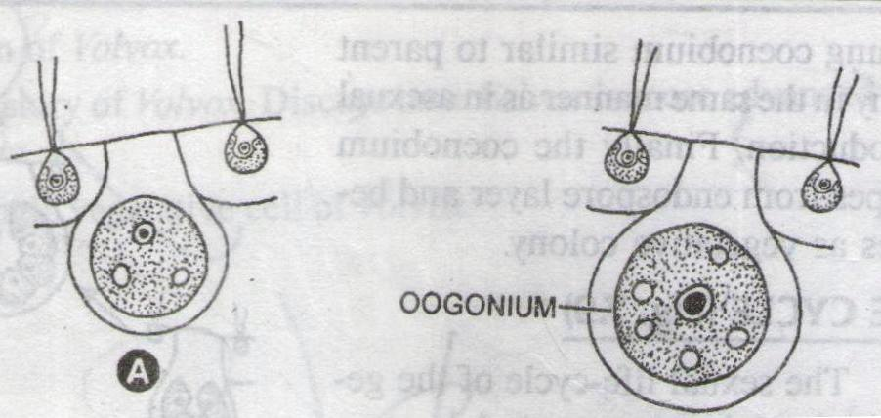
OOGONIA
The female gametangium e; larges in size and becomes rounded or flask-shaped The protoplasm does not divide, but metamorphosed into single, non-flagellated, green spherical egg or oosphere. The female gametangium is now called oogonium (or gynogonidium). It possesses a beak-like protru­sion or opening for the entry of antherozoids. A large number of oogonia may be produced in single coenobium.

Slide 11
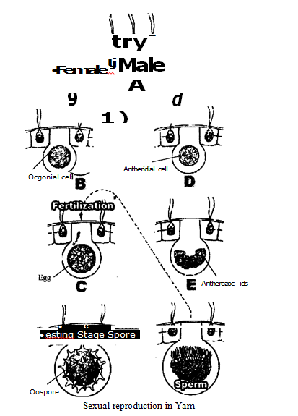
FERTILIZATION:
When mature, the oogonium secretes some chemical substance which attracts the antherozoids. The antherozoids are attracted chemotactically to­wards oogonium, enter through the beak and reach the mucilaginous mass of sheath. Only one antherozoid fuses with the egg from the side and the egg now become zygote.

Slide 12
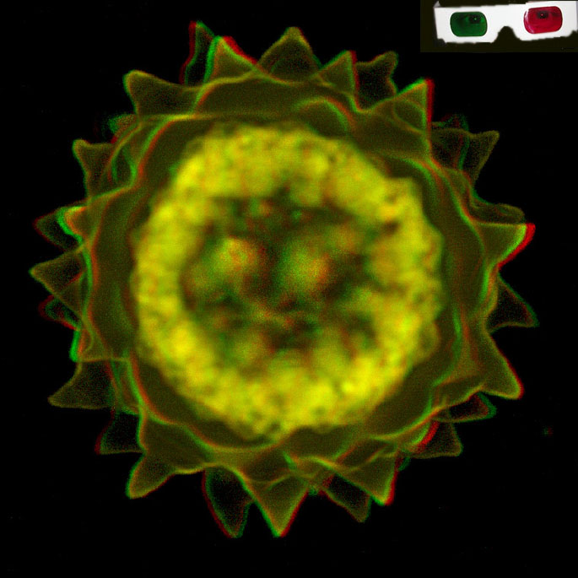
ZYGOTE
Usually t tie fusion of protoplast (plasmogamy) is not immediately followed fusion of nuclei (karyogamy). It may be delayed for some time. After the complete fusion of protoplast, nuclei and nucleoli, the diploid zygote enlarges in size. It secretes its own cell wall. The wall may be smooth or stellate. It is three layered—exospore, mesospore and endospore.

Slide 13
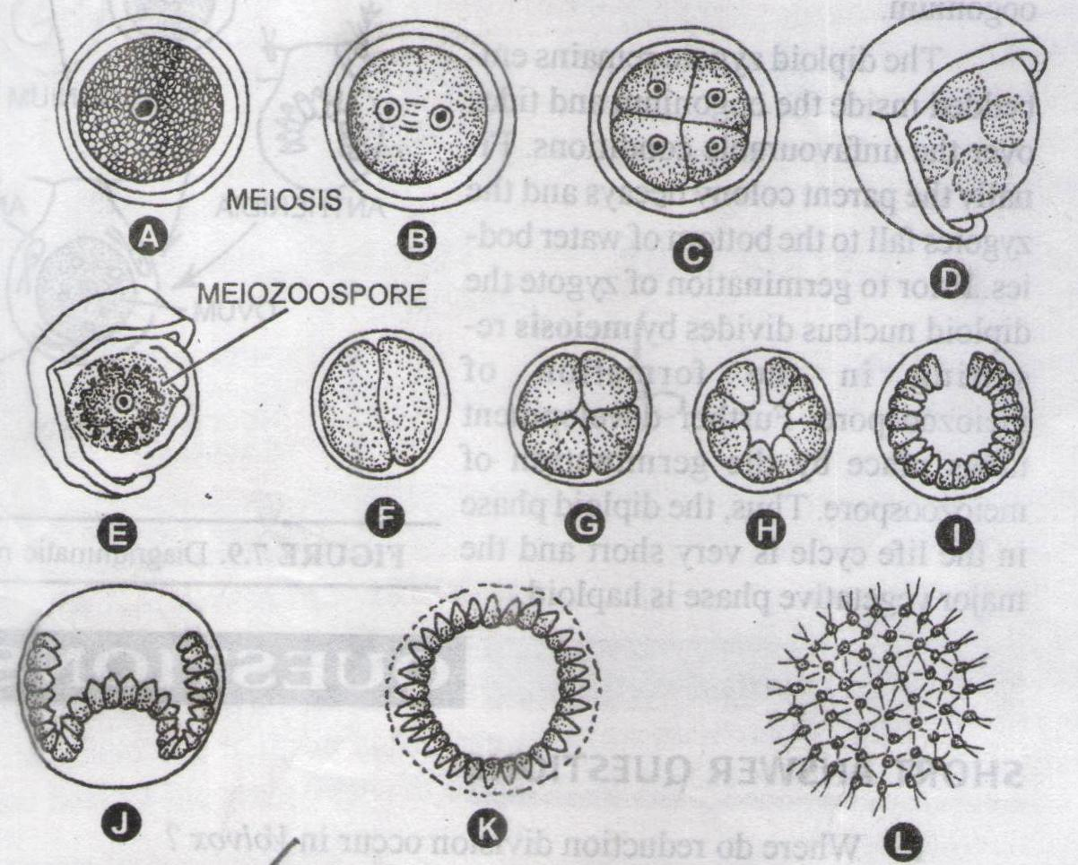
GERMINATION OF ZYGOTE
Priorto germination, the diploid nucleus of zygote divides by meiosis. At this stage the zygote has three layered wall— outer exospore, middle mesospore and inner endospore. The thick wall sur­rounds dense protoplasmi containing 4 haploid daughter nuclei.
In any case, the outer two layers of zygote-the exospore and mesospore gelatinise and separate The inner en­dospore protrudes out in the form of a vesicle. The functional haploid nucleus migrates into the vesicle.

Slide 14
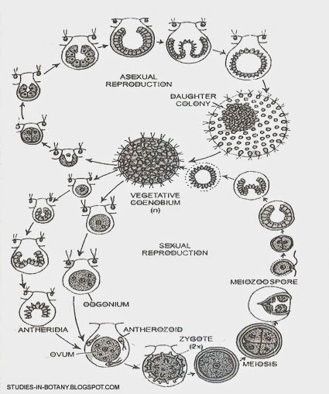
LIFE CYCLE OF VOLVOX

Slide 15
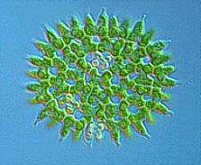
Economic importance of Algae
Habit & Habitat: Algae are chlorophyll-bearing, simple, thalloid, autotrophic and largely aquatic (both fresh water and marine) organisms. They occur in a variety of other habitats: moist stones, soils and wood. Some of them also occur in association with fungi (lichen) and animals (e.g., on sloth bear).
Size: The size ranges from the microscopic unicellular forms like Chlamydomonas, to colonial forms like Vol vox and to the filamentous forms like Ulothrix and Spirogyra. A few of the marine forms, such as kelps, form massive plant bodies.
Reproduction: The algae reproduce by vegetative, asexual and sexual methods.

Slide 16
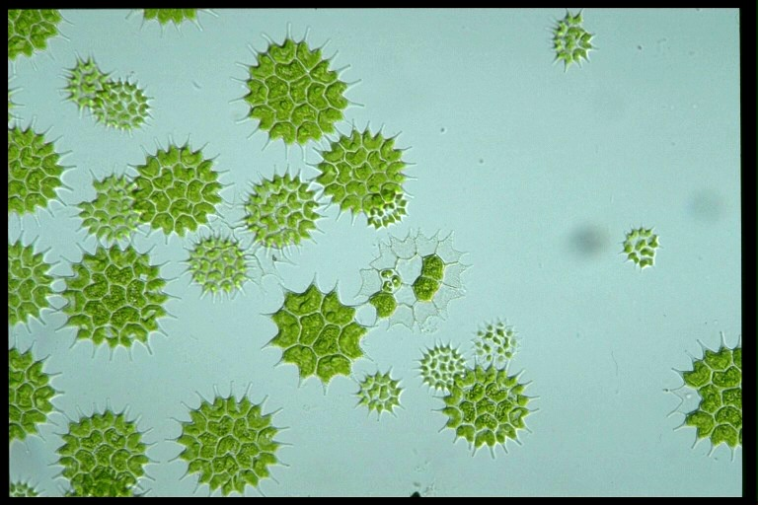
Importance of Algae
Algae are useful to man in a variety of ways. A t least a half of the to tal carbon dioxide fixation on earth is carried out by algae through photosynthesis. Being photosynthetic they increase the level of dissolved oxygen in their immediate environment. They are of paramount importance as primary producers of energy-rich compounds which form the basis of the food cycles of all aquatic animals. Many species of Porphyra, Laminaria and Sargassum are among the 70 species of marine algae used as food. Certain marine brown and red algae produce large amounts of hydrocolloids.

Slide 17
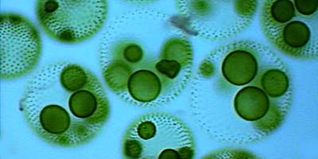
CHLOROPHYCEAE
Characteristics: The members of chlorophyceae are commonly called green algae. The plant body may be unicellular, colonial or filamentous. They are usually grass green due to the dominance of pigments chlorophyll a and b. The pigments are localised in definite chlorop/asts. The chloroplasts may be discoid, plate-like, reticulate, cup-shaped, spiral or ribbon-shaped in different species. Most of the members have one or more storage bodies calledpyrenoids located in the chlorop/asts. Pyrenoids contain protein besides starch. Some algae may store food m the form of oil droplets. Green algae usually have a rigid cell wall made of an inner layer of cellulose and an outer layer of pectose.

Slide 18
Thank You

